Slide 1
French Words and Phrases
J’ ai oublie’ beaucoup…

Slide 2
French Words and Phrases
In general:
the French do not pronounce the last letter in most words
the French roll their R’s with the back of the tongue (like a purring cat)
French social interactions and expectations have a long history that the French cling to (what is appropriate, etc.)

Slide 3
Bonjour
Bohn ZHUR
Hello / Good morning

Slide 4
Salut
Sah LOO
Hello / Good-bye

Slide 5
S’il vous plait
See voo PLAY
Please (If you please)

Slide 6
Merci
Mare see
Thank you

Slide 7
Monsieur
Mihs YUR
Sir / Mister

Slide 8
Madam
Muh DAM
Ma’am

Slide 9
Mademoiselle
Mad mwah ZEL
Miss

Slide 10
a bientot
Ah Bee EN toe
See you later

Slide 11
au revoir
awrv WAHR
Good-bye

Slide 12
Croissant
Crah SAHN
croissant

Slide 13
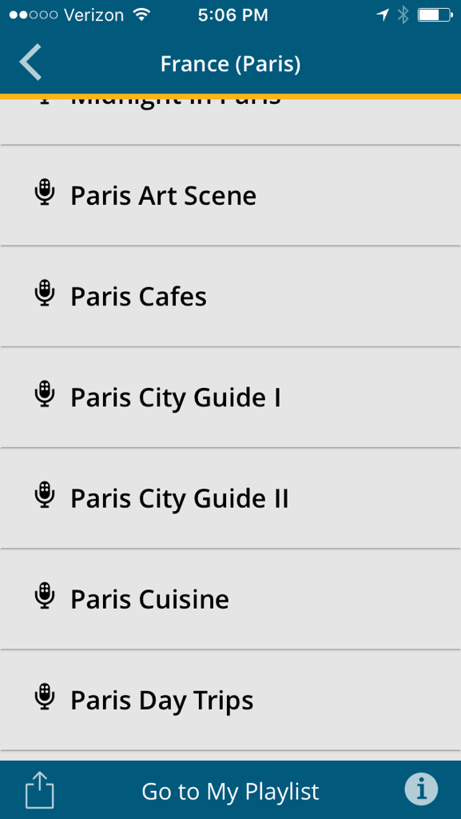
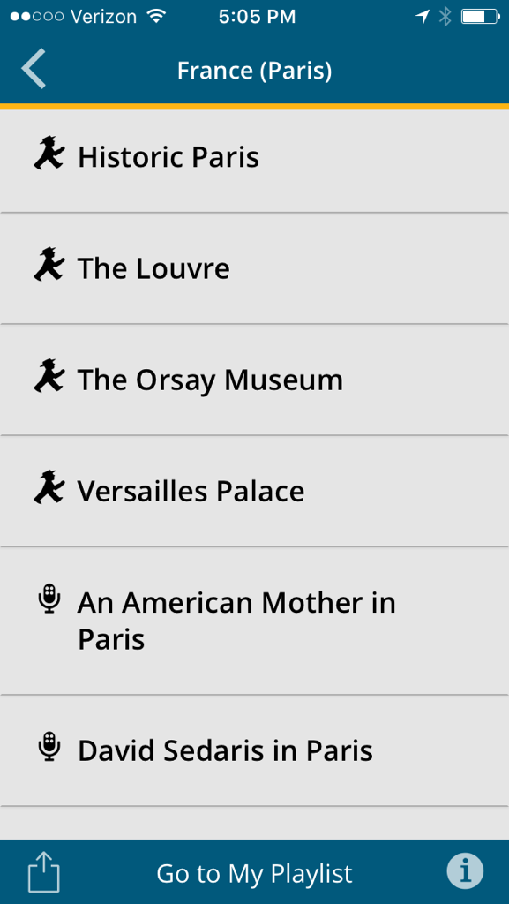
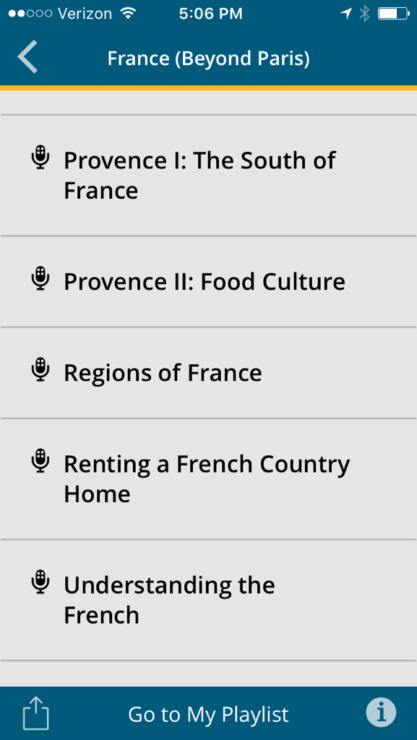
Rick Steves' Audio Europe
Audio tours, podcasts

Slide 14
Rick Steves' Audio Europe
Audio tours, podcasts

Slide 15
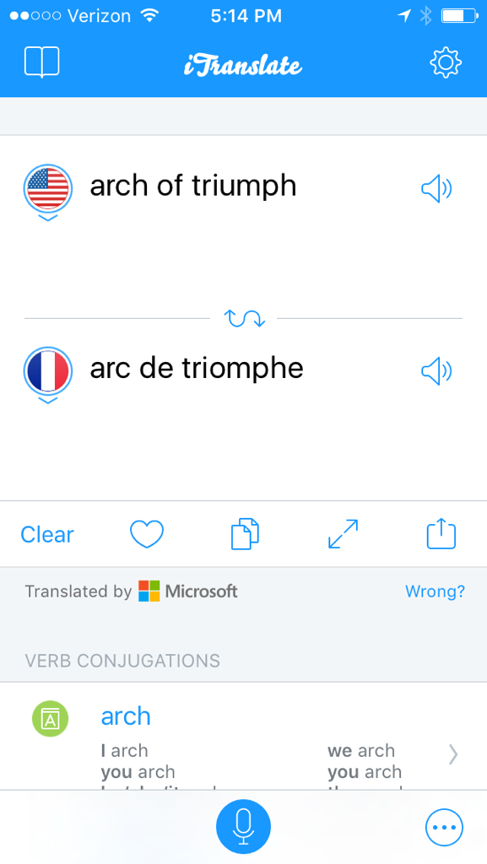
Translator Apps
Flash cards/memory, pronunciation

Slide 16
Le petit dejeuner Le pet TEA day zhe NAY
Breakfast

Slide 17
Dejeuner
Day zhe NAY
Lunch

Slide 18
Diner
Dee NAY
Dinner

Slide 19
Excusez-moi
Eks QUE zay MWAH
Excuse me (to interrupt)

Slide 20
Pardonez-moi (pardon)
Par DOAN ay mwah
Pardon me (to get past)

Slide 21
Ou est...
Ooh ay...
Where is...

Slide 22
La Tour Eiffel
Lah tour ef EL
The Eiffel Tower

Slide 23
La Cathedrale de Notre Dame
Lah cat ay DRELL de NOH truh DAHM
The Notre Dame Cathedral

Slide 24
L'Arc de Triomphe
Lark de tree OHMF
The Arch of Triumph

Slide 25
Arrondisement
Ah ROHN deez mohn
District

Slide 26
Arrondisements de Paris

Slide 27
Isle de la Cite
EEL de lah see TAY
Island of the City

Slide 28
Isle Saint Louis EEL San LooEE
Saint Louis Island

Slide 29
Le Quartier Latin Le CART ee ay La TAN
The Latin Quarter

Slide 30
Rive Gauche Reeve GOHSH
Left Bank

Slide 31
Rive Droit Reeve DWAHT
Right Bank

Slide 32
Les Toilettes Lay Twah LET
The bathrooms

Slide 33
Je ne parle pas Francais Zhe nuh parl PAH Frahn SAY
I don’t speak French

Slide 34
Je l’aime Zhe LEM
I love it

Slide 35
Ca c’est bien Sah say BeYEN
It’s good

Slide 36
Puis J’avoir… Pwee zhah vwahr
May I have…
*

Slide 37
un, deux, trois uhn, deh, twah
One, two, three

Slide 38
quatre, cinque, seise CAH tr, sank, cease
Four, five, six

Slide 39
sept, huit, neuf, dix set, wheat, noof, deese
Seven, eight, nine, ten

Slide 40
Combien? Cohm beYEN
How much?

Slide 41
En Anglais Uhn Ahn GLAY
In English

Slide 42
Aidez-moi A day MWAH
Help me

Slide 43
Beaucoup Boh COO
Very much

Slide 44
En peu uhn PEH
A little

Slide 45
Oui / Non WE / NOHN
Yes / No

Slide 46
Bon Soir Bohn SWAHR
Good evening

Slide 47
Fromage Fro MAHZH
Cheese

Slide 48
Pain Peh
Bread

Slide 49
Baguette Bag ET
French bread loaf

Slide 50
Pain au Chocolat Peh Oh Shock oh LAH
croissant with chocolate

Slide 51
Café / Café au Lait Ka FAY / Ka FAY Oh LAY
Espresso / Latte

Slide 52
Café Americain Ka FAY A mare E KEH
Coffee (as we know it)

Slide 53
Jambon Zham BOH
Ham

Slide 54
Des Oeufs Days UHF
Eggs

Slide 55
Jus d’Orange Zhoo Door AHNGE
Orange Juice

Slide 56
Grand / Petit GRAHN / Pet TEA
Big / Small
*

Slide 57
Entrée / Sortie Ahn TRAY / Sore TEA
Entrance / Exit

Slide 58
d’ accord Dah CORE
Okay

Slide 59
Parlez-vous Anglais? PAR lay VOO Ahn GLAY
Do you speak English?

Slide 60
Je ne comprends pas Zhe ne com PROHN PAH
I don’t understand

Slide 61
A Quelle Heure Ah Kell ER
At what time?

Slide 62
Chaud / Froid SHOW / FWAH
Hot / Cold

Slide 63
De Rien Deh Ree EH
It’s nothing / You’re welcome

Slide 64
Musee / Musee du Louvre Mew ZAY / Mew ZAY do LOOVR
Museum / Louvre Museum

Slide 65
Jardin / Palais Zhar DEH / Pal LAY do
Garden / Palace

Slide 66
Gare / Gare du Nord GAR / GAR do NOR
Train Station / North Station

